Slide 1
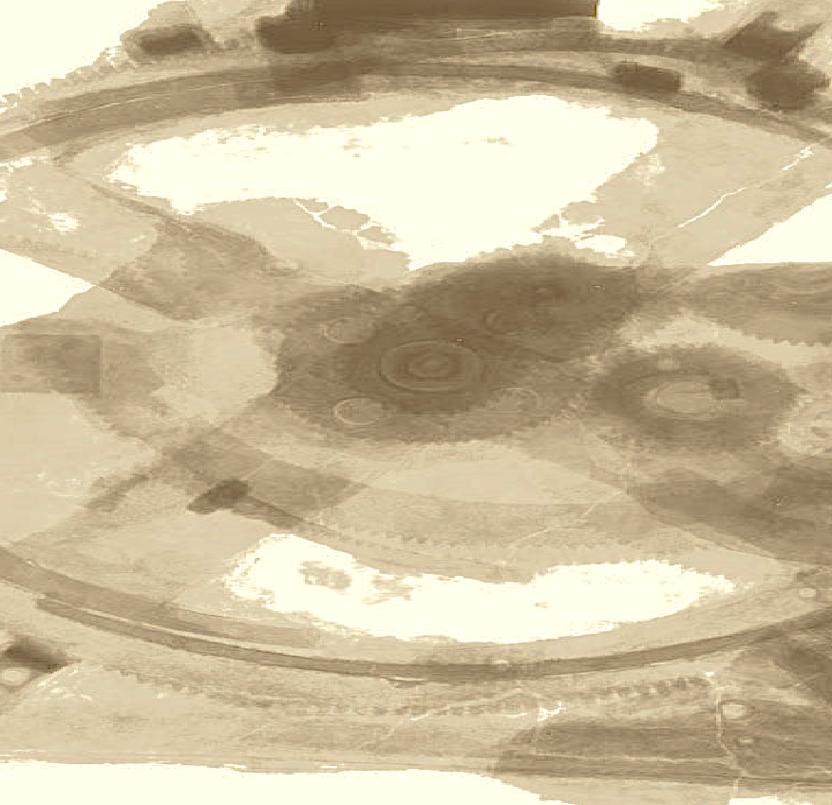

Drops of LTSpice
What is possible to do with the waveform?

Slide 2
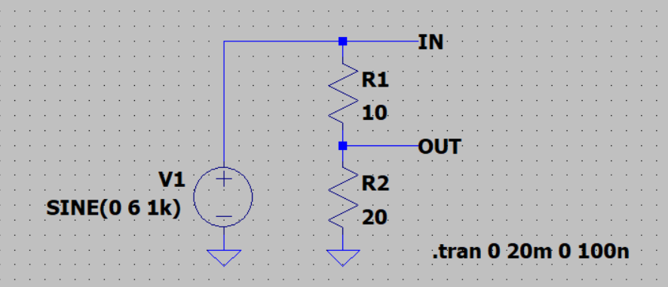
Let's imagine you have a simple voltage divider.
Note that we use Label Net to name the wires.

Slide 3
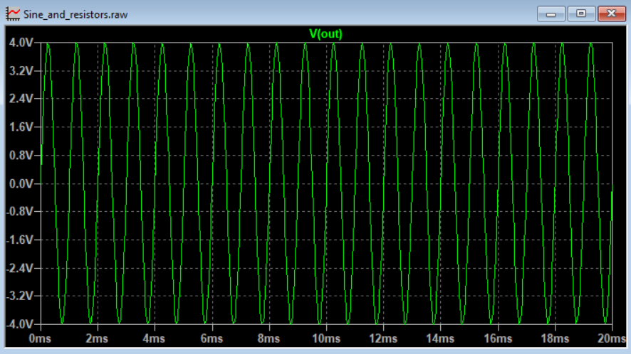
Running the simulation, we have the waveform of the OUT signal.
The waveform is relative to ground, in other words, the voltage across R2.

Slide 4
But what if I want the voltage across R1?
How to measure just this voltage?

Slide 5
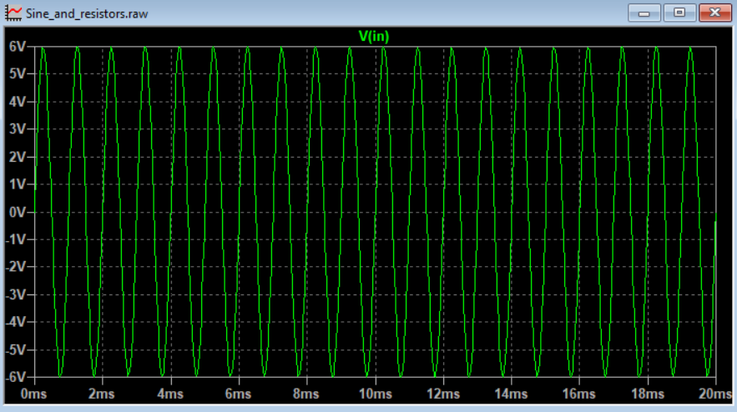
Measuring V(IN) is not a solution, as the voltage is in relation to ground.
It is the voltage of the source V1, not the voltage of the resistor R1.

Slide 6
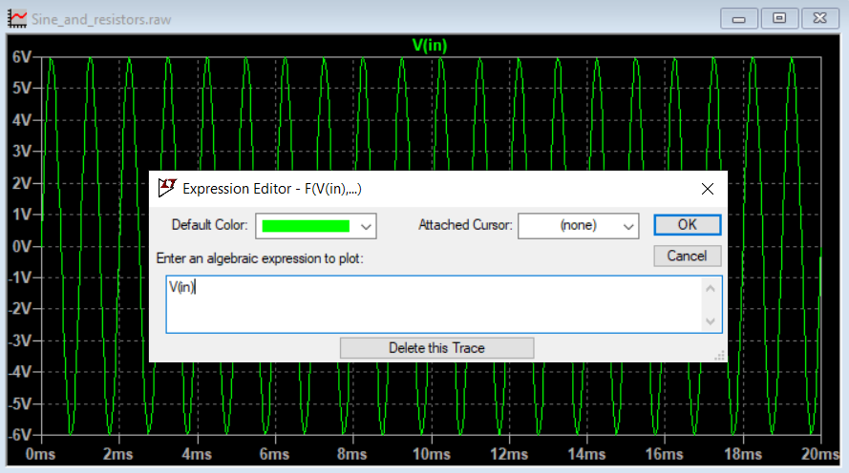
There are some ways to solve this problem!
First, right-click to open the Expression Editor.

Slide 7
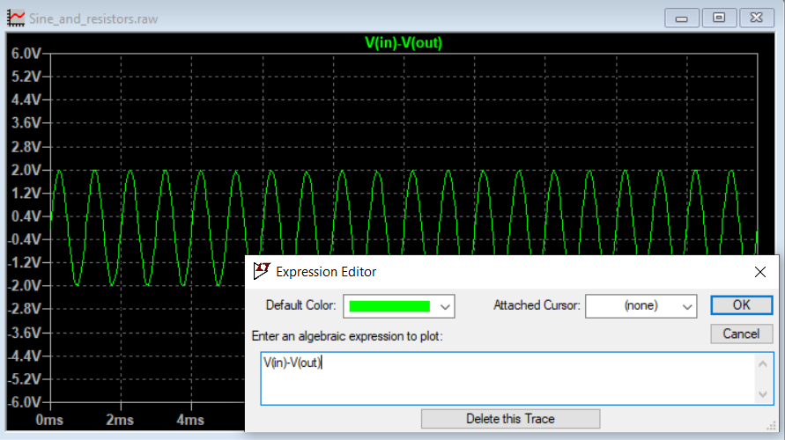
You can subtract the voltage
V(IN) and V(OUT).
This is the voltage across R1.

Slide 8
You can subtract the voltage
V(IN) and V(OUT).
This is the voltage across R1.

Slide 9
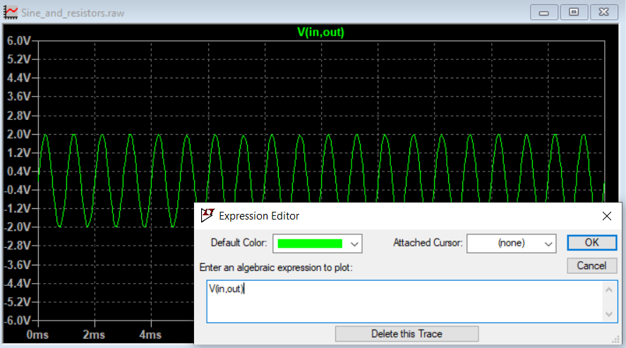
LTSpice also allows you to simplify this using V(IN,OUT).
The result is the same.

Slide 10
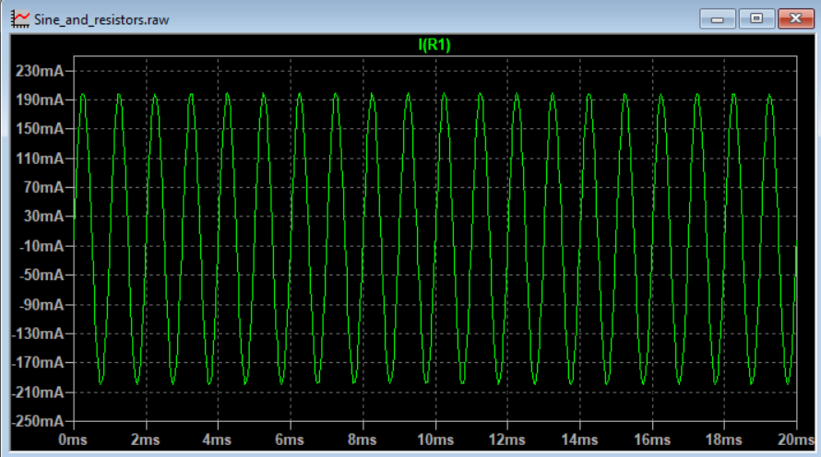
You can measure the current through resistor R1 using I(R1)
Notice that the Y axis has changed to current automatically.

Slide 11
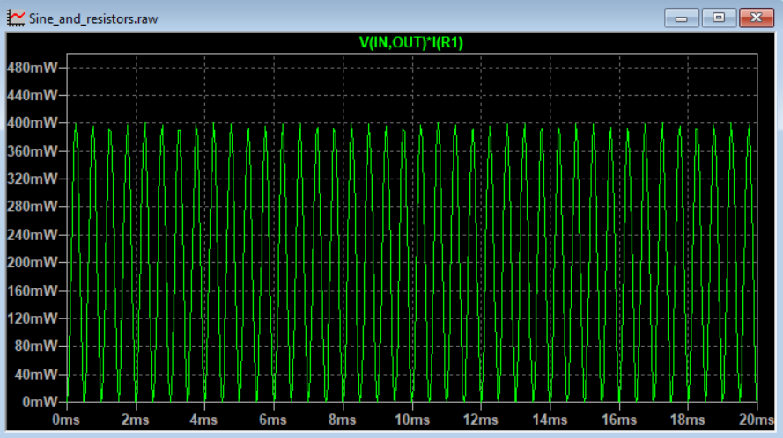
It is even possible to calculate the power over R1 using
V(IN,OUT) * I(R1)
And the Y axis now shows the power.

Slide 12
It is even possible to calculate the power over R1 using
V(IN,OUT) * I(R1)
And the Y axis now shows the power.

Slide 13
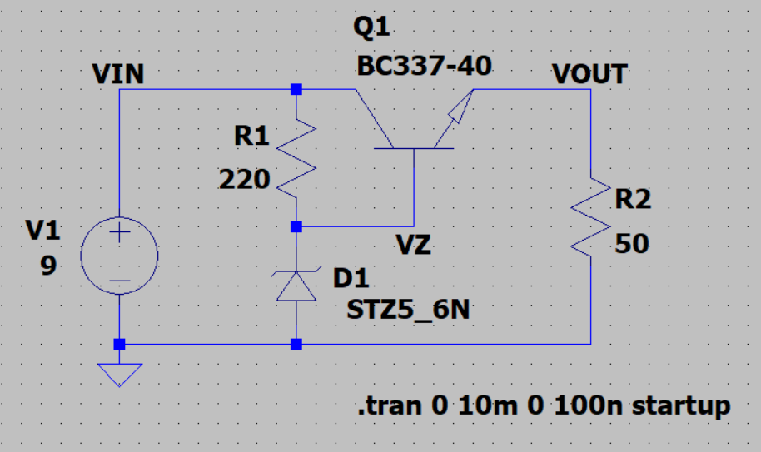
Let's imagine that now you have a standard linear regulator.
Its input is 9V and its load R2 is regulated with 5V.

Slide 14
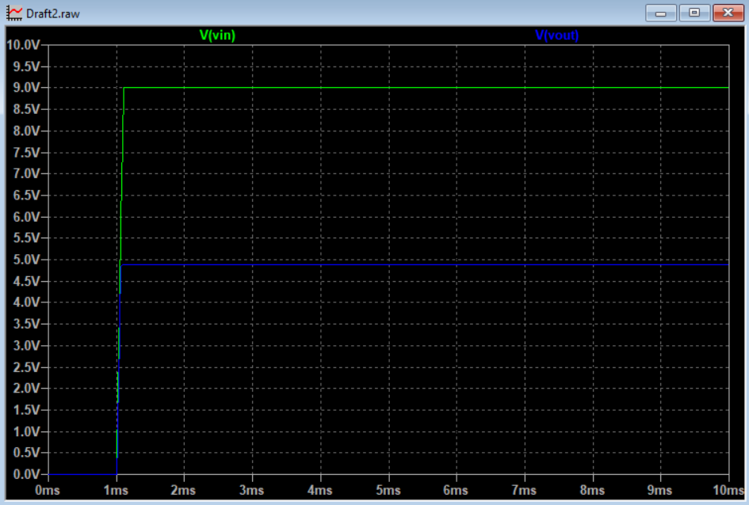
You already know that you can measure input and output voltage.

Slide 15
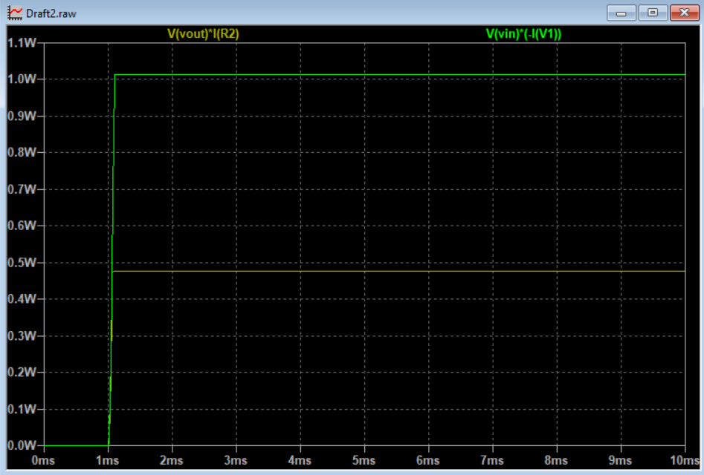
But using the right formula, you can present the in/out power.
Note that the source current is negative because of the direction.

Slide 16
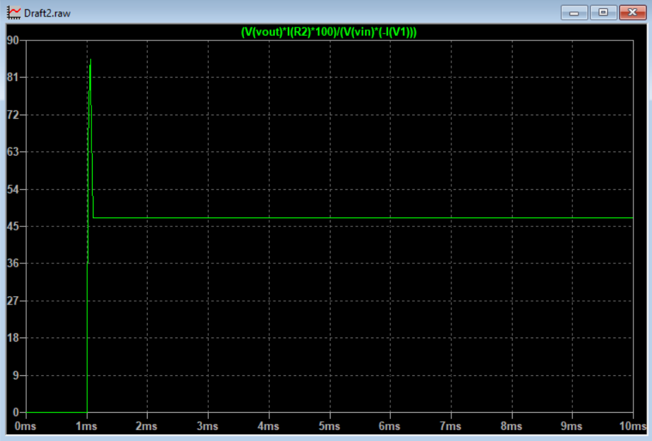
Calculating correctly, even efficiency becomes easy to visualize.
Francesco Sacco
linkedin.com/in/saccofrancesco

